Slide 1
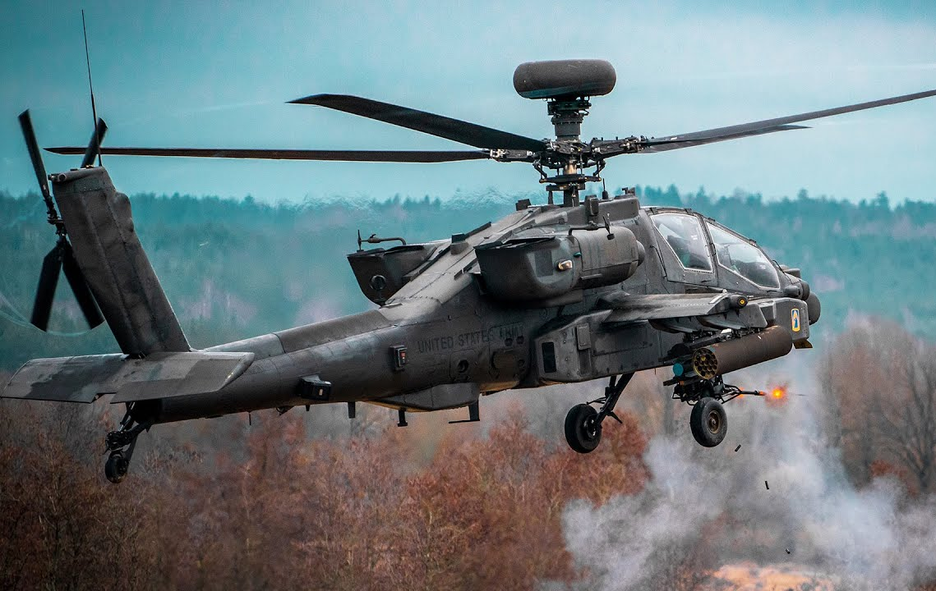
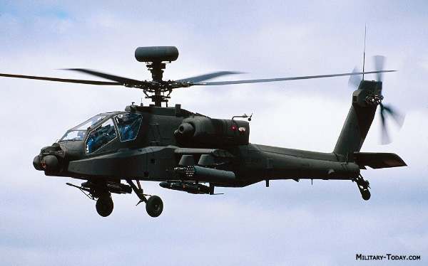
Boeing AH-64D Apache Longbow
By: Asher Miller

Slide 2

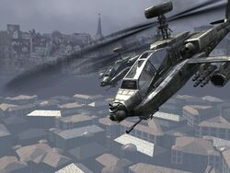
WHY?
Apache’s are cool
Notes:
Do I need a better reason?

Slide 3

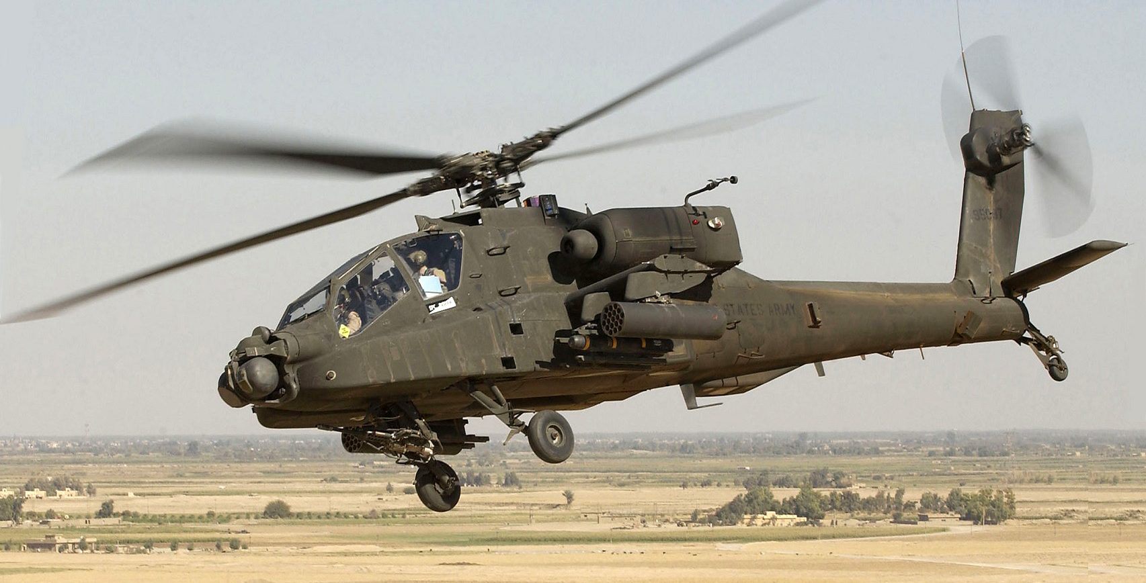

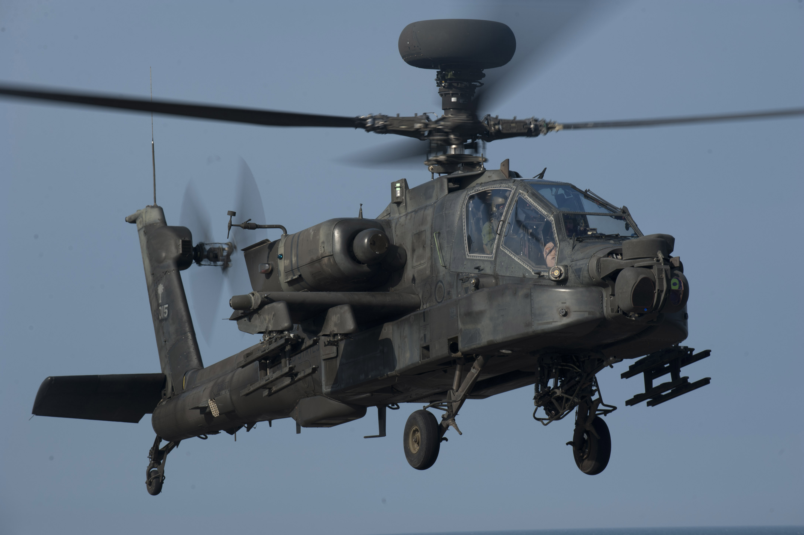


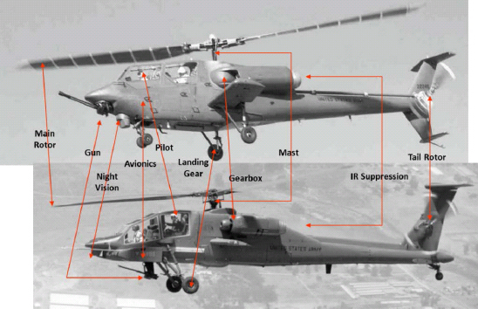

TF an AH-64D?
Notes:
2 types of apache ah-64’s, A’s and D’s. D’s are the newer model called the longbow. Prototype AH-64 first flown in 1976, old ass design that’s in the process of being replaced soon. AH-64D produced delivered to the army in 1997. AH-64D’s pitted against AH-64A’s in testing and demonstrated a 7x greater survivability and 4x greater lethality. Apache’s can be seen in nearly every modern conflict.

Slide 4
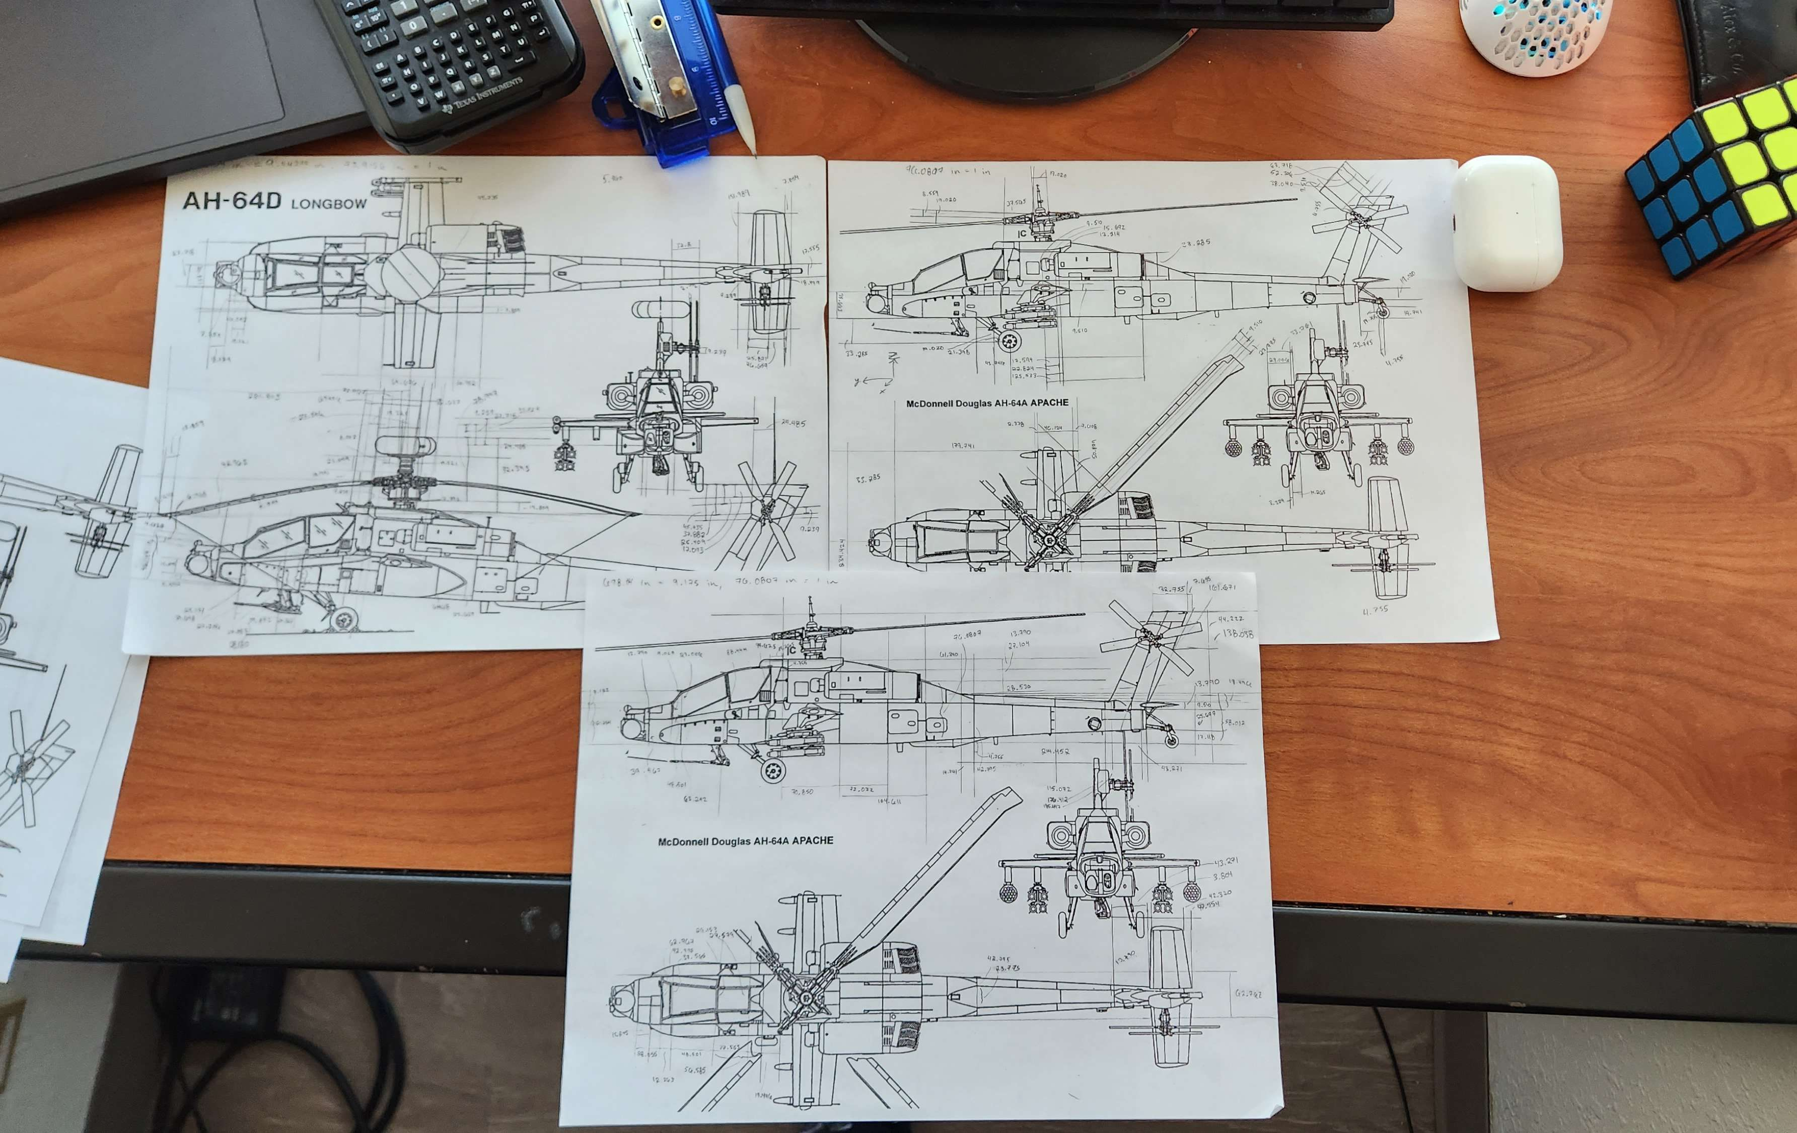
Dimensioning (HELL)
Notes:
Used diagrams and pictures from different angles for references and help finding hidden dimensions. Ruler and conversion factor based on some real known dimensions for visible dimensions.

Slide 5
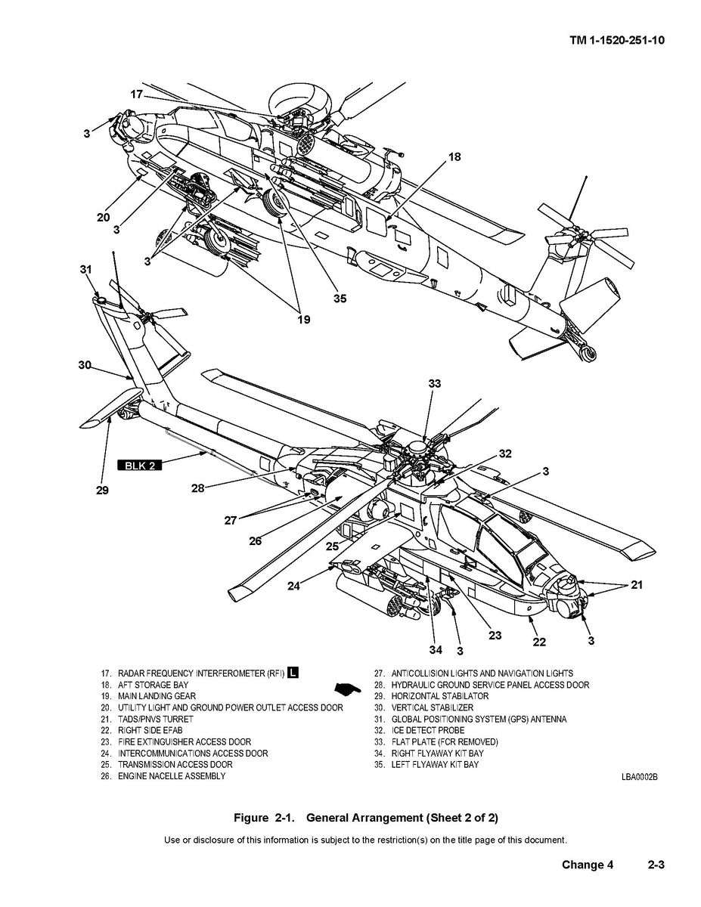
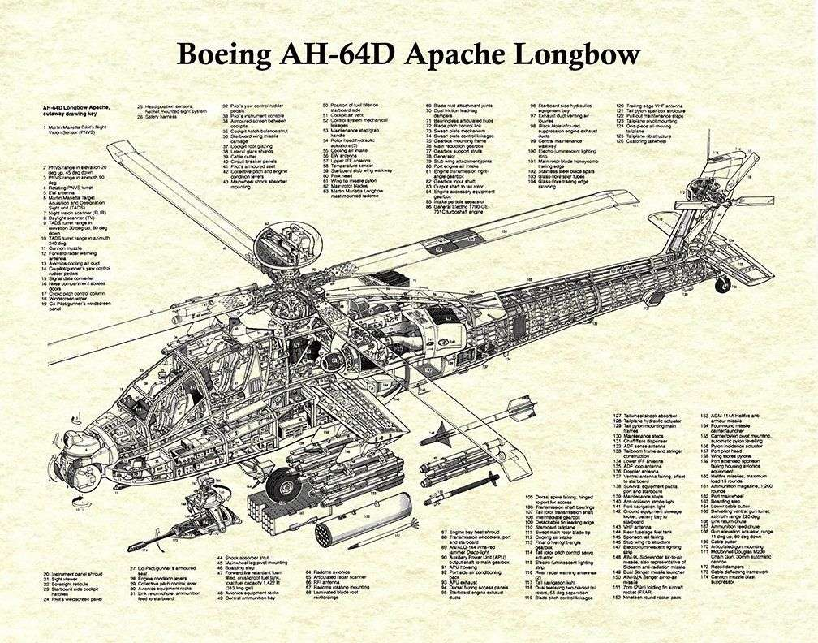
Notes:
Incredibly useful diagrams especially for hidden views.

Slide 6
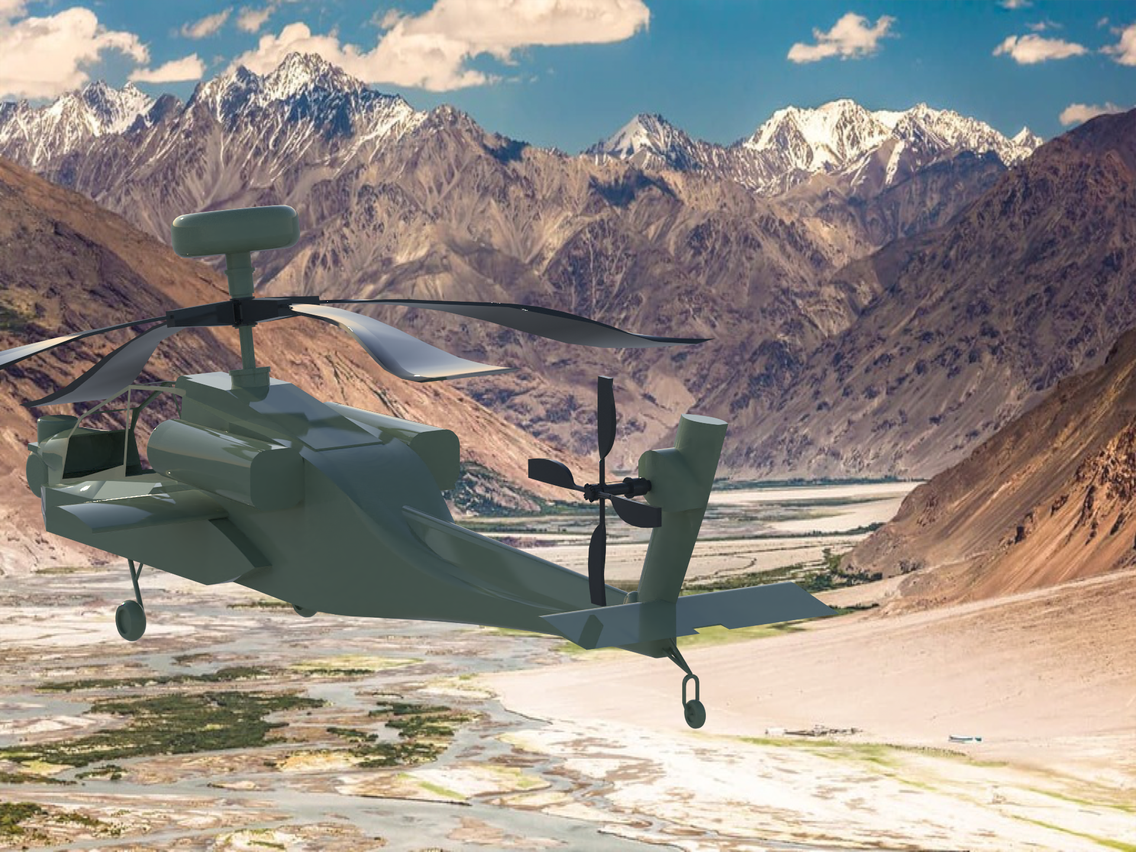
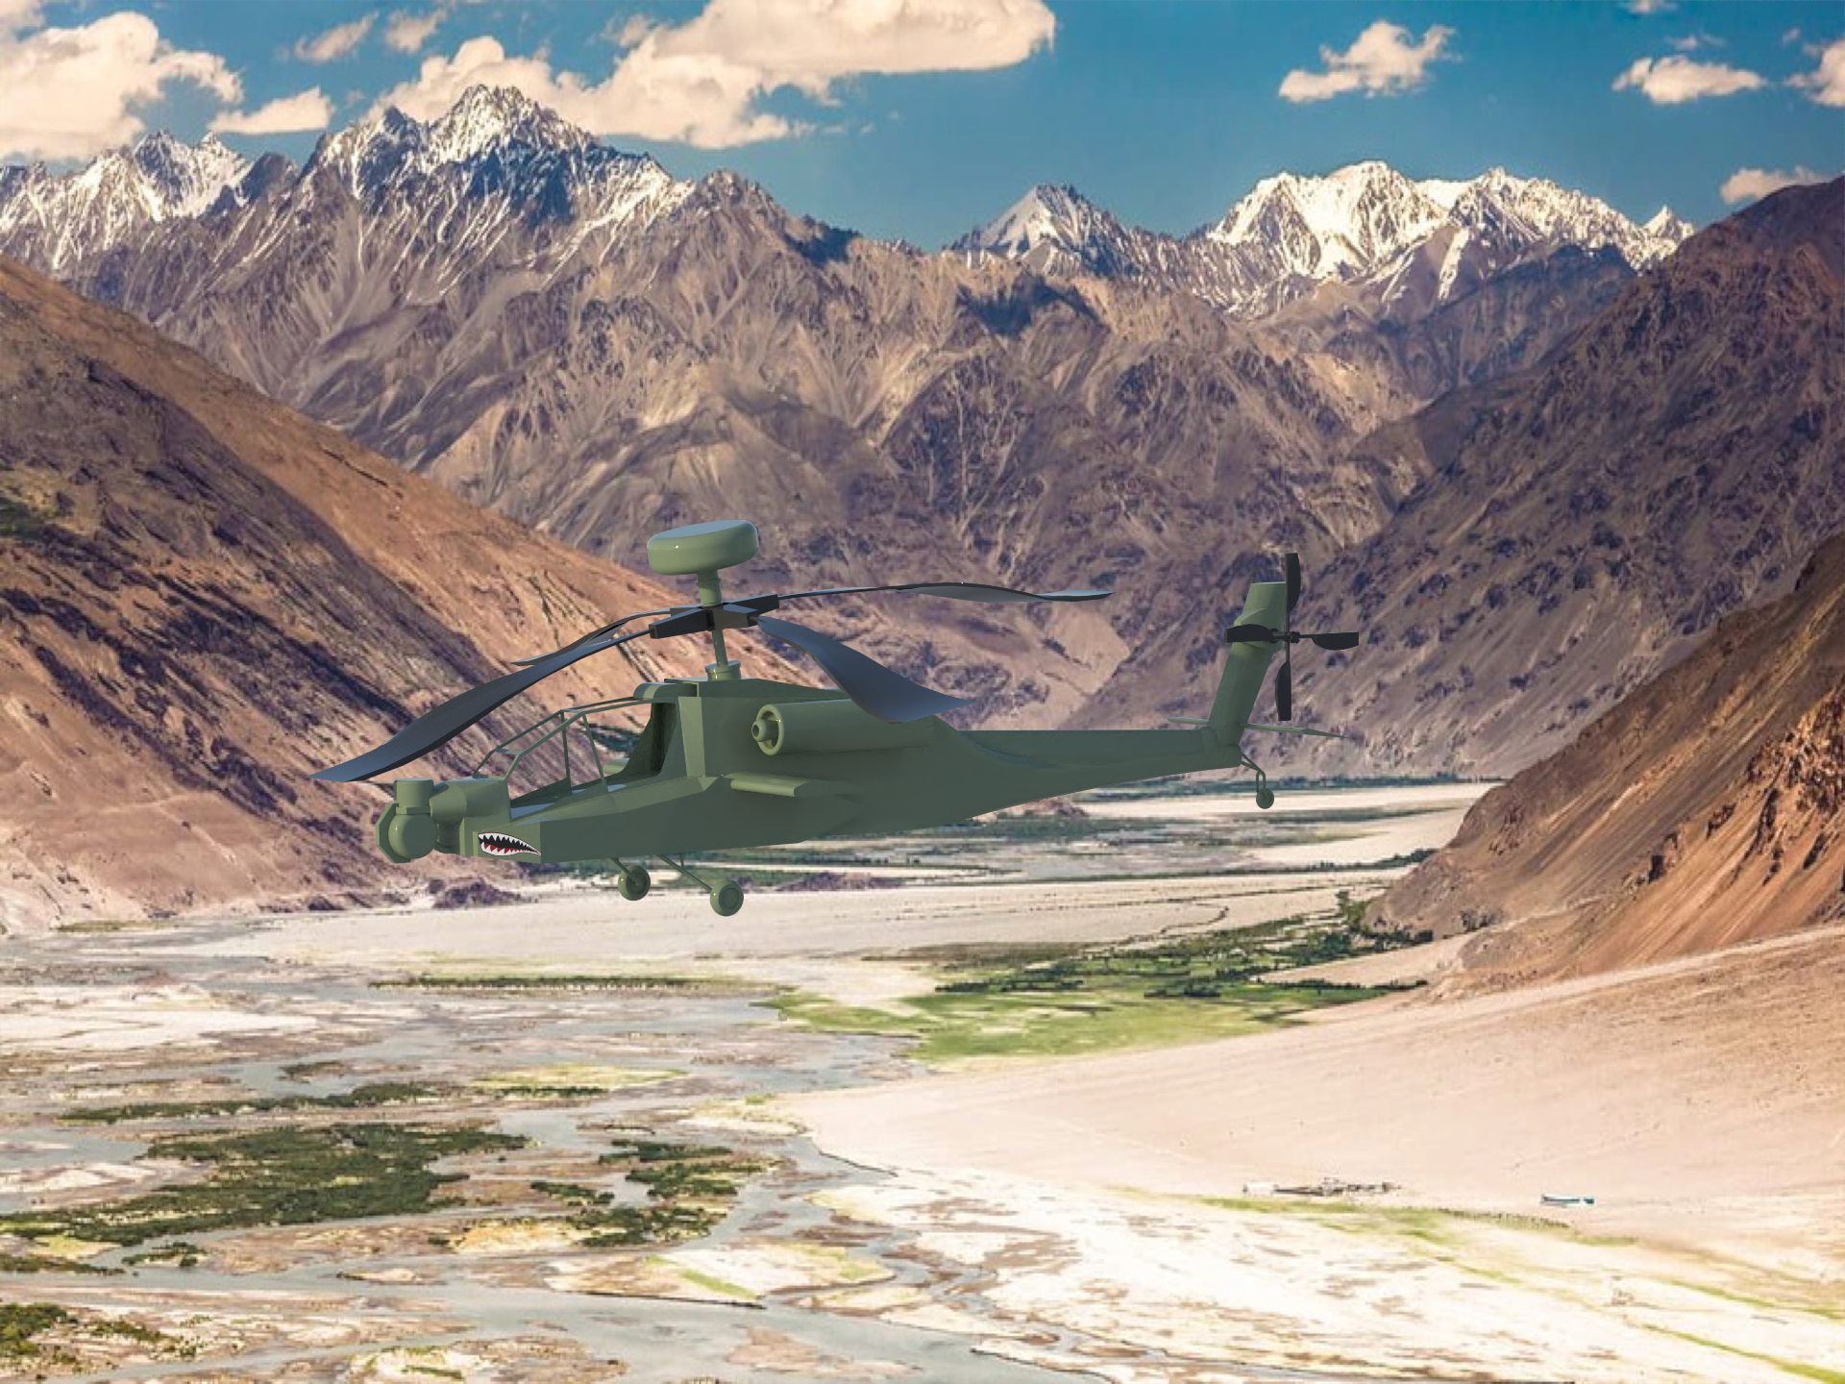
Renders

Slide 7
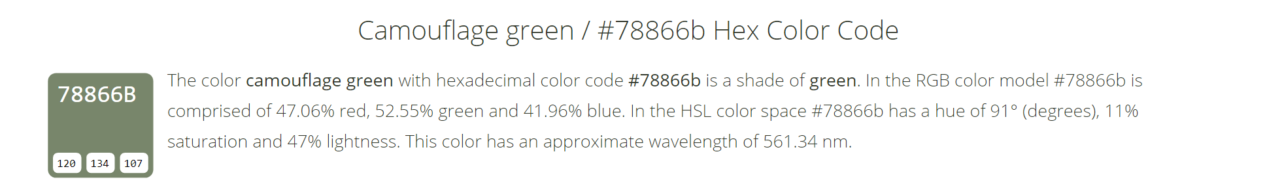

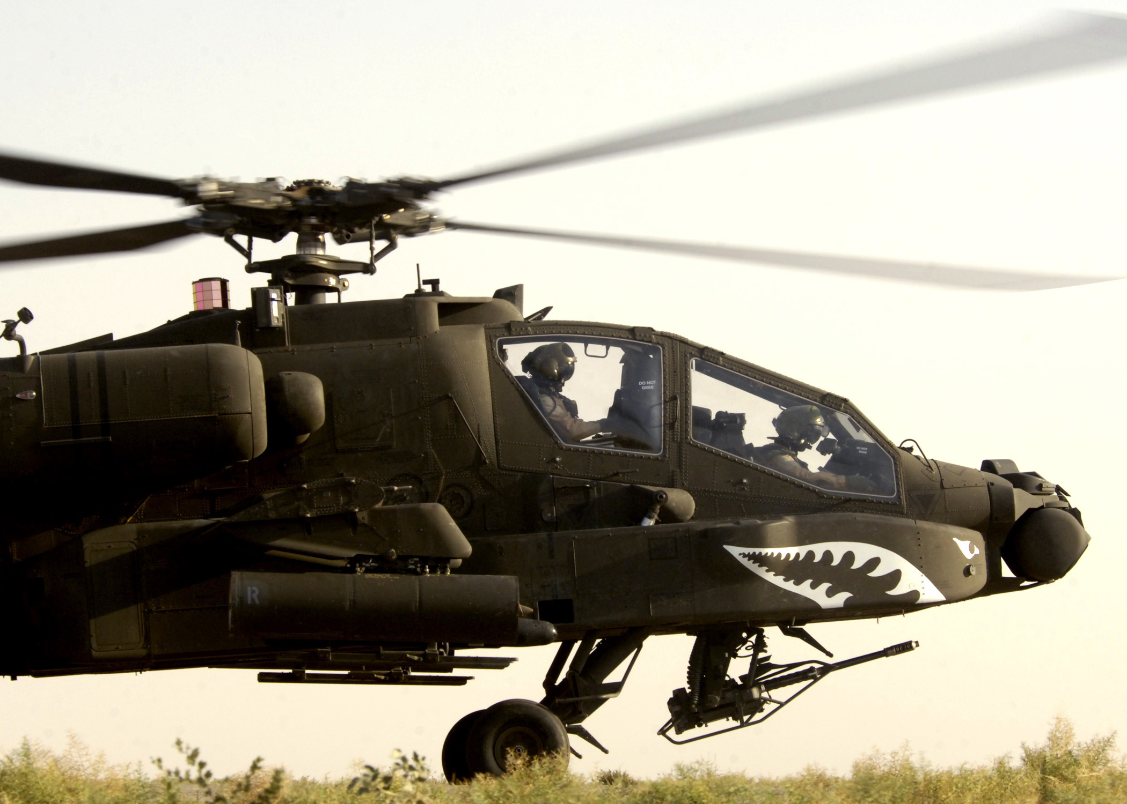
Decal and Colors
Notes:
Shark Teeth and Eye is a common decal people place on military vehicles

Slide 8
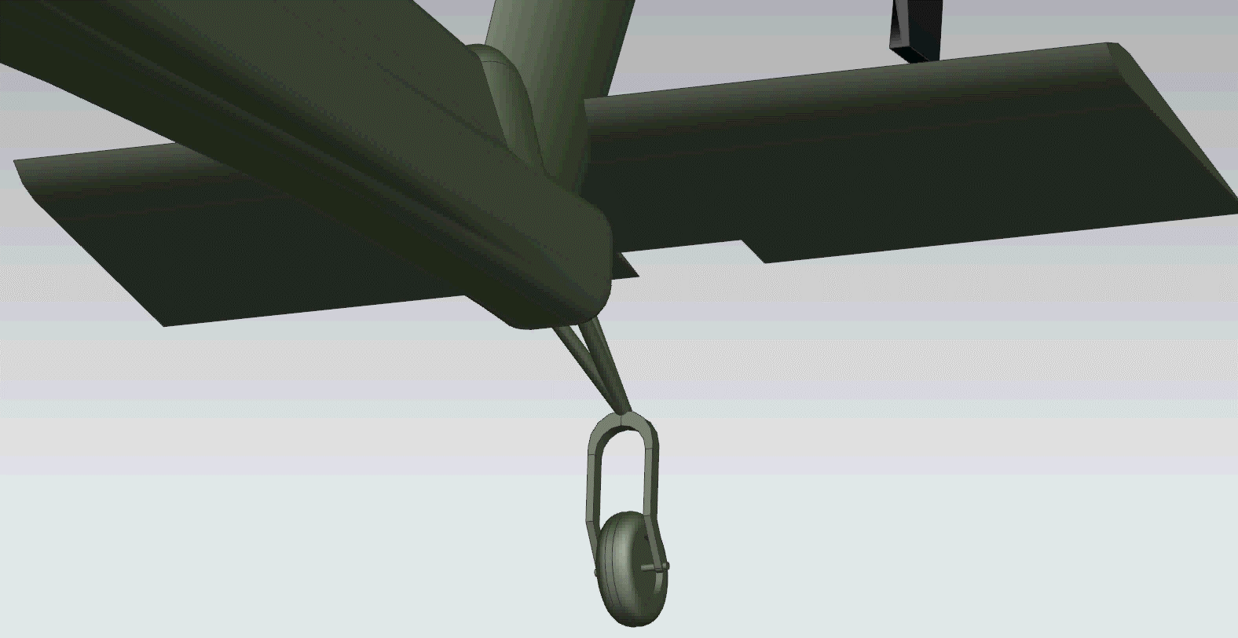
Movie (apologies for the choppiness)

